Slide 1

Exploring
#2 Strings & Numbers

Slide 2
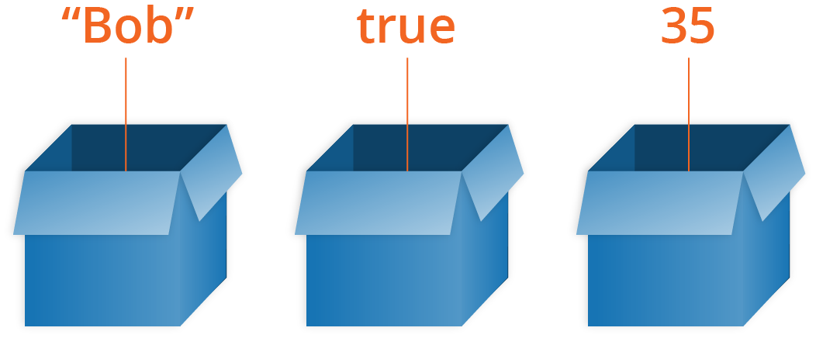
Variable
Variables are named containers and can store any type of JavaScript values/data values.

Slide 3
Variable
var nama = 'Andi';
console.log(nama);
var usia = 22;
console.log(usia);
let jomblo = true;
console.log(jomblo);

Slide 4
Naming Variables
Variable names rules:
Start them with a letter, underscore (_), or dollar sign ($).
After the first letter you can use numbers, letters, underscores (_), or dollar sign ($).
Don’t use any JavaScript’s reserved keywords, such as var, let, this, etc.

Slide 5
When to use it?
We should use variable only if the data or value is used more than once. Its for the purpose of saving space, because everytime we make a variable, it used RAM space.
Like the examples above when we create 3 variables (nama,usia,jomblo) its actually such a waste of space and time, because the values (‘Andi’,22,true) is only used once.

Slide 6
Prompt & Alert
<write on HTML!>
var kabar = prompt('Apa kabar?'); //muncul kotak dialog input
console.log(kabar); //tampilkan input di console
alert(kabar);
//tampilkan input di alert window

Slide 7
Comment
To comment and uncomment a code/block of codes in Visual Studio Code easily, you just need to block the codes you want to comment or uncomment, and then press ctrl + /.
// komentar 1 line
/*
komentar multiline
komentar multiline
komentar multiline
*/

Slide 8
Data Type
let nama = 'Andi';
let usia = 22;
let jomblo = true;
let kerja;
console.log(typeof(nama));
console.log(typeof(usia));
console.log(typeof(jomblo));
console.log(typeof(kerja));
console.log(kerja);

Slide 9
Primitive Data Type
String : kumpulan char, text
Number : integer / float
Boolean : logic data type, true/false
Undefined : variabel tanpa value

Slide 10
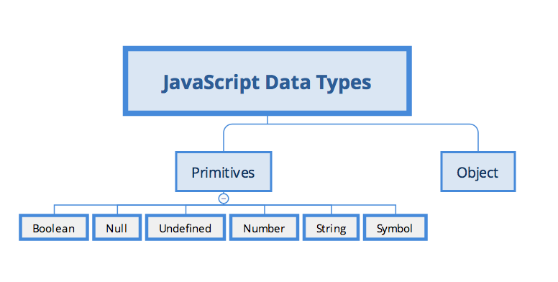
Data Type

Slide 11
var vs let vs const
The details about this will be explained in the future after you learn about if else, and function, but here is the list of the differences, and we will explain it to you point 2,3,and 4 only for now:
var declarations are globally scoped or function scoped while let and const are block scoped.
var variables can be updated and re-declared within its scope; let variables can be updated but not re-declared; const variables can neither be updated nor re-declared.
They are all hoisted to the top of their scope but while var variables are initialized with undefined, let and const variables are not initialized.
While var and let can be declared without being initialized, const must be initialized during declaration.

Slide 12
var vs let vs const (point 2)
var variables can be re-declared and updated
var greeter = "hey hi";
var greeter = "say Hello instead";
and this also
var greeter = "hey hi";
greeter = "say Hello instead";

Slide 13
var vs let vs const (point 2)
let can be updated but not re-declared.
Just like var, a variable declared with let can be updated within its scope. Unlike var, a let variable cannot be re-declared within its scope. So while this will work,
let greeting = "say Hi";
greeting = "say Hello instead";
this will return an error.
let greeting = "say Hi";
let greeting = "say Hello instead";//error: Identifier 'greeting' has already been declared

Slide 14
var vs let vs const (point 2)
const cannot be updated or re-declared
This means that the value of a variable declared with const remains the same within its scope. It cannot be updated or re-declared. So if we declare a variable with const, we can neither do this
const greeting = "say Hi";
greeting = "say Hello instead";//error : Assignment to constant variable.
nor this
const greeting = "say Hi";
const greeting = "say Hello instead";//error : Identifier 'greeting' has already been declared

Slide 15
var vs let vs const (point 3)
Hoisting of var
Hoisting is a JavaScript mechanism where variables and function declarations are moved to the top of their scope before code execution. What this means is that if we do this:
console.log (greeter);
var greeter = "say hello"
it is interpreted as this
var greeter;
console.log(greeter); //greeter is undefined
greeter = "say hello"
So var variables are hoisted to the top of its scope and initialized with a value of undefined.

Slide 16
var vs let vs const (point 3)
Hoisting of let
Just like var, let declarations are hoisted to the top. Unlike var which is initialized as undefined, the let keyword is not initialized. So if you try to use a let variable before declaration, you'll get a Reference Error.
Hoisting of const
Just like let, const declarations are hoisted to the top but are not initialized.

Slide 17
var vs let vs const (point 4)
var and let can be declared without being initialized, so this wont make an error :
var a;
let b;
but const must be initialized when its being declared, so this will make an error :
const c; //SyntaxError: Missing initializer in const declaration

Slide 18
Strings
var x = 'Halo Dunia';
console.log(x.length);
console.log(x.indexOf('Dunia'));
console.log(x.substr(5, 3));
console.log(x.slice(5, 8));
console.log(x.split(' ')); //split spasi

Slide 19
Strings
var x = 'halo';
var y = 'DUNIA';
var z = 12345;
console.log(x.toUpperCase());
console.log(y.toLowerCase());
console.log(x.replace('ha', 'mi'))
console.log(x.replace(/ha/g, 'mi'))
console.log(z.toString())
console.log(typeof(z.toString()))

Slide 20
Convert Strings to Numbers
parseInt('123');
parseFloat('123');
parseInt('1234.5678');
parseFloat('1234.5678');
parseInt('Halo Dunia');
parseFloat('Halo Dunia');

Slide 21
Convert Strings to Numbers
let a = parseInt('123');
let b = parseFloat('123');
let c = parseInt('1234.5678');
let d = parseFloat('1234.5678');
let e = parseInt('Halo Dunia');
let f = parseFloat('Halo Dunia');
console.log(a)
console.log(b)
console.log(c)
console.log(d)
console.log(e)
console.log(f)

Slide 22
Convert Strings to Numbers
let a = parseInt('123');
let b = parseFloat('123');
let c = parseInt('1234.5678');
let d = parseFloat('1234.5678');
let e = parseInt('Halo Dunia');
let f = parseFloat('Halo Dunia');
console.log(typeof(a))
console.log(typeof(b))
console.log(typeof(c))
console.log(typeof(d))
console.log(typeof(e))
console.log(typeof(f))

Slide 23
Adding Strings & Numbers
let usia = 22;
let nama = 'Andi';
console.log(usia + usia);
console.log(nama + ' ' + nama);
console.log(nama + usia);
/*
Type Coersion: saat dua variabel
beda tipe digabungkan, akan
diconvert ke String.
*/

Slide 24
Numbers
var a = 3.14;
var b = 3;
var c = 123e5; // 123 x 10⁵
var d = 123e-5; // 123 x 10⁻⁵
var e = 999999999999999; // 15x
var f = 9999999999999999; // 16x
var g = 0.2 + 0.1;
var h = (0.2 * 10 + 0.1 * 10) / 10;

Slide 25
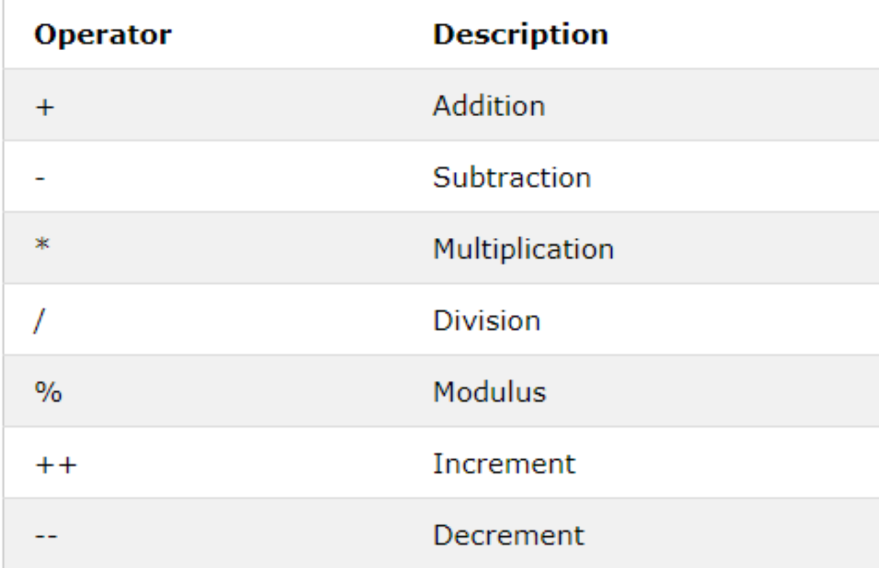
Arithmetic Operators

Slide 26
Arithmetic
Operators
var usiaAndi = 40;
var usiaBudi = 20;
console.log(usiaAndi * usiaBudi);
console.log(usiaAndi / usiaBudi);
console.log(usiaAndi + usiaBudi);
console.log(usiaAndi - usiaBudi);
console.log(usiaAndi % usiaBudi);
console.log(usiaAndi ** usiaBudi);

Slide 27
Arithmetic
Operators
var usiaAndi = 40;
var usiaBudi = 20;
usiaAndi++ // usia Andi +1
usiaAndi++
console.log(usiaAndi);
usiaBudi-- // usia Budi -1
usiaBudi--
console.log(usiaBudi);

Slide 28
Arithmetic
Operators
var usiaAndi = 40;
var usiaBudi = 20;
usiaAndi+=2;
// usiaAndi = usiaAndi+2
usiaBudi*=2;
// usiaBudi = usiaBudi*2
console.log(usiaAndi);
console.log(usiaBudi);

Slide 29
Basic Math Object
console.log(Math.PI);
console.log(Math.abs(-4.7));
console.log(Math.pow(8, 2));
console.log(Math.sqrt(64));
console.log(Math.cbrt(8));

Slide 30
Round, Ceil & Floor
console.log(Math.round(4.7));
console.log(Math.round(4.4));
console.log(Math.floor(4.7));
console.log(Math.ceil(4.4));

Slide 31
Random, Max & Min
console.log(Math.random());
console.log(Math.max(1,3,5));
console.log(Math.min(1,3,5));

Slide 32
Basic Date Object
let a = new Date()
console.log(a.getFullYear())
console.log(a.getMonth())
console.log(a.getDate())
console.log(a.getDay())
console.log(a.getHours())
console.log(a.getMinutes())
console.log(a.getSeconds())
console.log(a.getMilliseconds())

Slide 33
Basic Date Object
getFullYear() Get year (yyyy)
getMonth() Get month (0-11)
getDate() Get day as a number (1-31)
getDay() Get weekday number (0-6)
getHours() Get hour (0-23)
getMinutes() Get minutes (0-59)
getSeconds() Get seconds (0-59)
getMilliseconds() Get milliseconds (0-999)
getTime() Get time (ms since Jan 1, 1970)

Slide 34
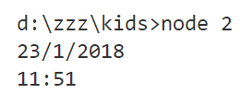
Basic Date Object

Slide 35
Learning Resources
https://www.w3schools.com/js/js_variables.asp
https://www.w3schools.com/js/js_operators.asp
https://www.w3schools.com/js/js_arithmetic.asp
https://www.w3schools.com/js/js_assignment.asp
https://www.w3schools.com/js/js_datatypes.asp
https://www.w3schools.com/js/js_strings.asp
https://www.w3schools.com/js/js_string_methods.asp
https://www.w3schools.com/js/js_numbers.asp
https://www.w3schools.com/js/js_number_methods.asp
https://www.w3schools.com/js/js_dates.asp
https://www.w3schools.com/js/js_date_methods.asp
https://www.w3schools.com/js/js_date_methods_set.asp
https://www.w3schools.com/js/js_math.asp
https://www.w3schools.com/js/js_random.asp

Slide 36


Solve It! #1
$$if x=4, y=3 \& z=2$$
$$w={\left(\frac{x+y×z}{x×y}\right)}^{z}= ?$$

Slide 37
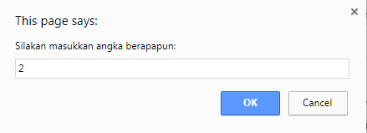
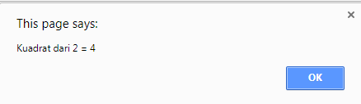
Solve It! #2

Slide 38

Solve It! #3
$$\sqrt[3]{8}= ?$$

Slide 39
Solve It! #4
485 hari.
Nyatakan dalam tahun, bulan, minggu dan hari.
*1 bulan = 30 hari, 1 tahun = 360 hari.

Slide 40
Solve It! #5
Saat ini, jumlah usia Andi & Budi = 49 th, dengan rasio Usia Andi & Budi = 0.4.
Berapa usia Andi & Budi
2 tahun lagi?

Slide 41
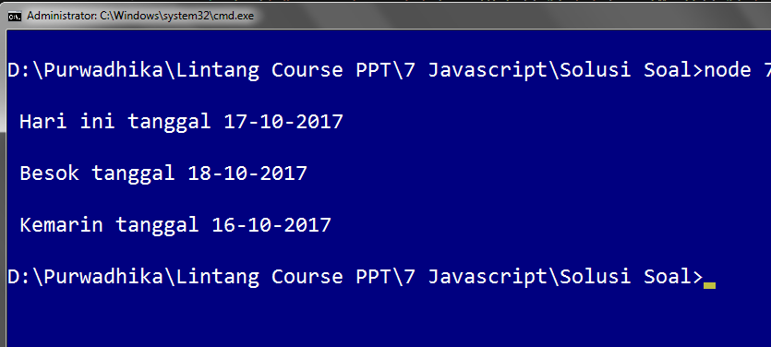
Solve It! #6

Slide 42
Solve It! #7
Buatlah algoritma untuk menghitung karakter tertentu dalam String!
Misal: “Halo Dunia” memiliki
huruf ‘a’ sebanyak 2 buah.

Slide 43
Solve It! #8
Jarak mobil A & B = 120 km.
A berjalan 60km/h dari timur.
B berjalan 40km/h dari barat.
A & B start pukul 9 WIB.
Jam brp A & B bertabrakan?

Slide 44
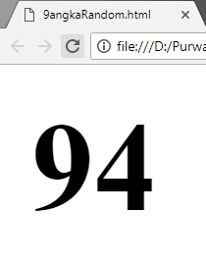
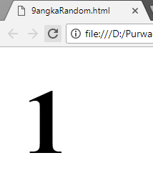
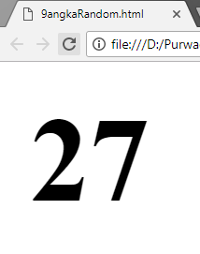
Solve It! #9
Tampilkan bilangan acak
(antara 1-100) di Browser

Slide 45
Exploring
#2 Strings & Numbers

